Slide 1
PlayStation App Store
Team 4:
Sudarshan Choudhari, Amanda Lewandowski,
Akash Suryavanshi, Zach Wormstadt

Slide 2
The Product
Playstation 4 Models
PS4
PS4 Slim
PS4 Pro
Accessories
DUALSHOCK 4 Controller
Midnight Blue
Magna Red
Glacier White
Playstation Move Controller
Gold Wireless Headset
Virtual Reality
HD Camera

Slide 3
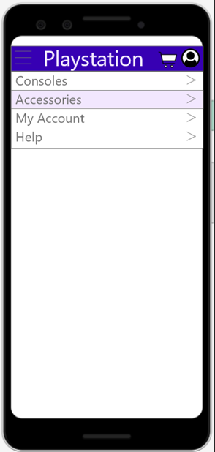
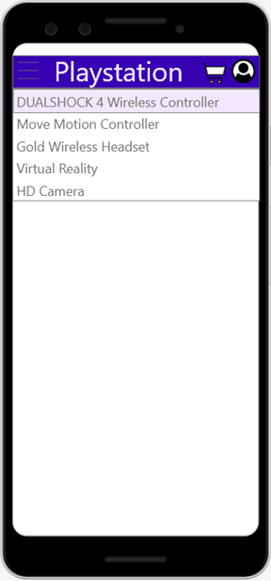
Mock Ups
Menu Pages

Slide 4
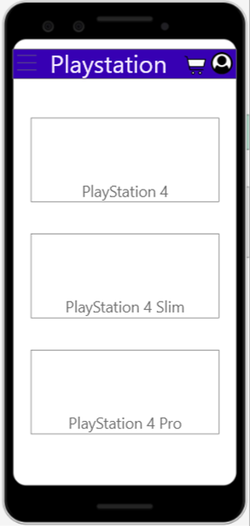
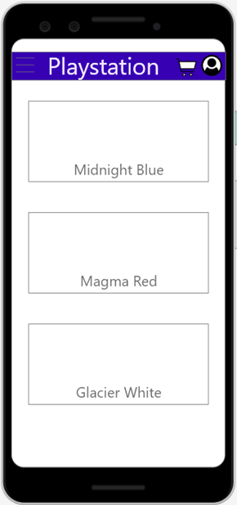
Mock Ups
Product Pages

Slide 5
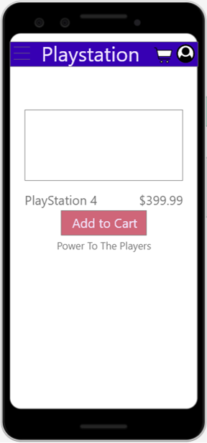
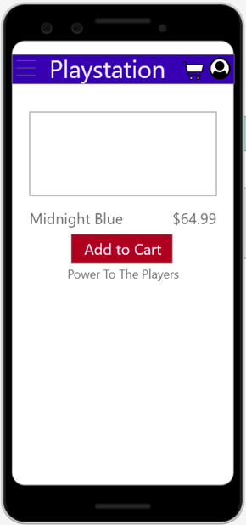
Mock Ups
Specific Product Pages

Slide 6
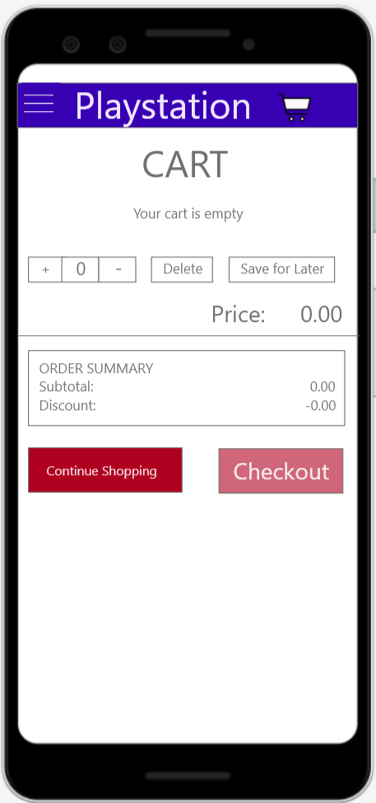
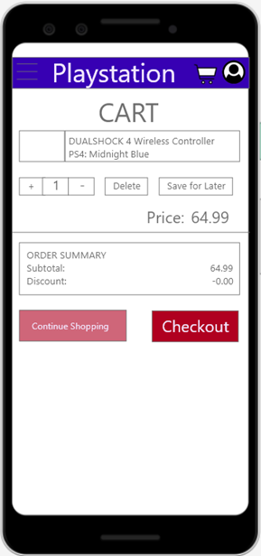

Mock Ups
Cart Page

Slide 7
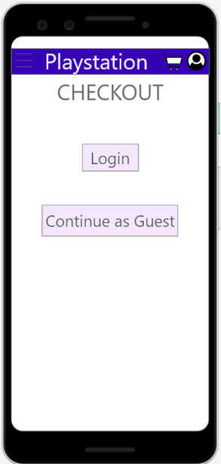
Mock Ups
Login or Guest Page

Slide 8
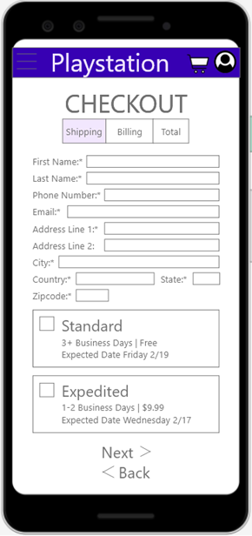
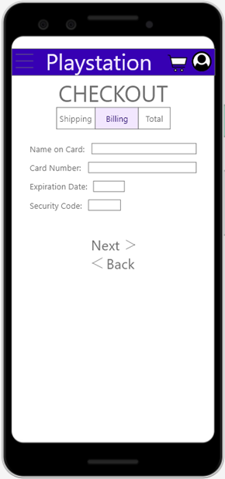
Mock Ups
Fill-in Information Pages

Slide 9
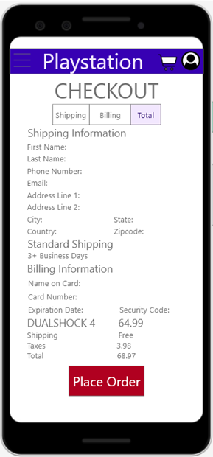
Mock Ups
Place Order Page

Slide 10
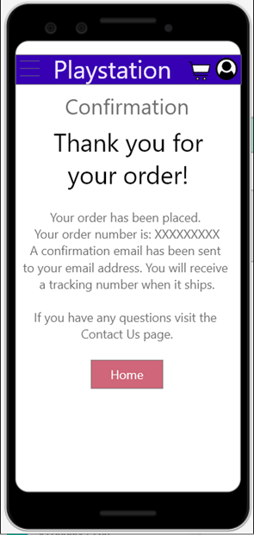
Mock Ups
Confirmation Page

Slide 11
Mock Ups
Confirmation Page

Slide 12
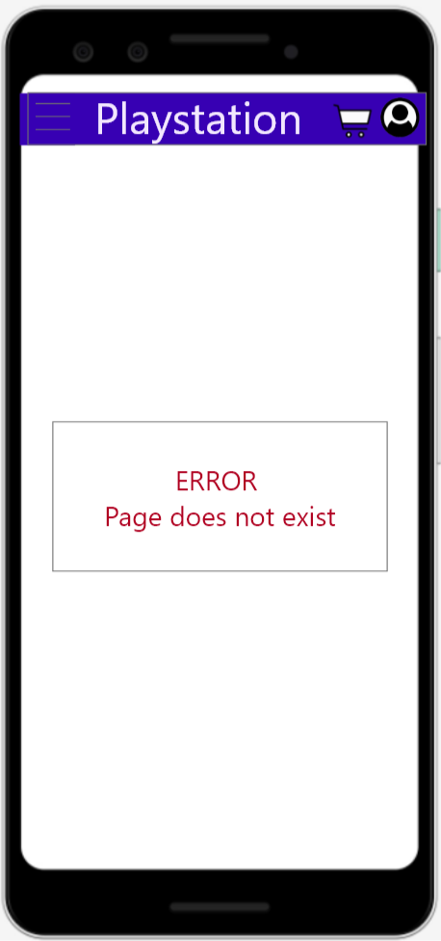
Mock Ups
Error Page

Slide 13
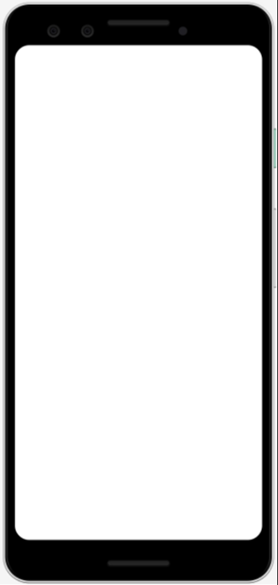
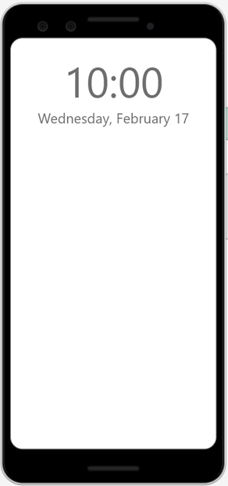
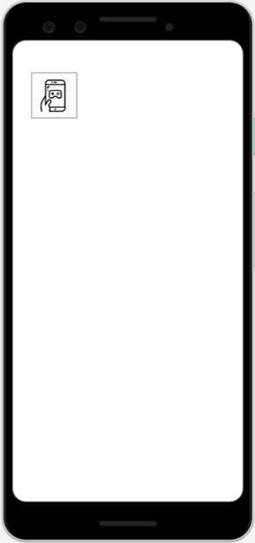
Storyboard
Blank Screen
Lock Screen
App Screen
Home Page
PS4 Page
Home Page

Slide 14
Storyboard Cont
Menu
Accessories Menu
Controller Page
Midnight Blue Page
Cart Page

Slide 15
Storyboard Cont
Checkout Login
Shipping Page
Billing Page
Total Page
Confirmation Page

Slide 16
Live Demo

